Slide 1
Introduction to Control Systems
Jaden Bottemiller
Rachel Kon

Slide 2
Aspects of controlling the robot
Communication - Creating a system to transfer instructions and data
Wiring - Laying the pipe for communications
Programming - Generating Instructions for the robot

Slide 3
Communication
Telling things what to do

Slide 4
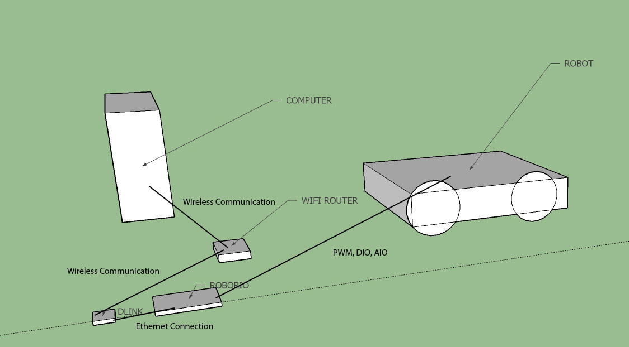
Brief Overview

Slide 5
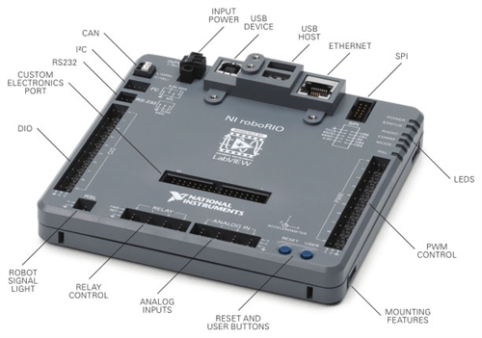
NI roboRIO (Main Control Board)

Slide 6
Wiring
Communication pathways

Slide 7
Wire Types and Components
Stranded vs Solid Core
Male vs. Female
10 – 22 AWG
Smaller the number the thicker the wire
PWM (3-wire ribbon cable)
Crimp Connectors
Anderson Connectors
Solder Connections

Slide 8
How to wire

Slide 9
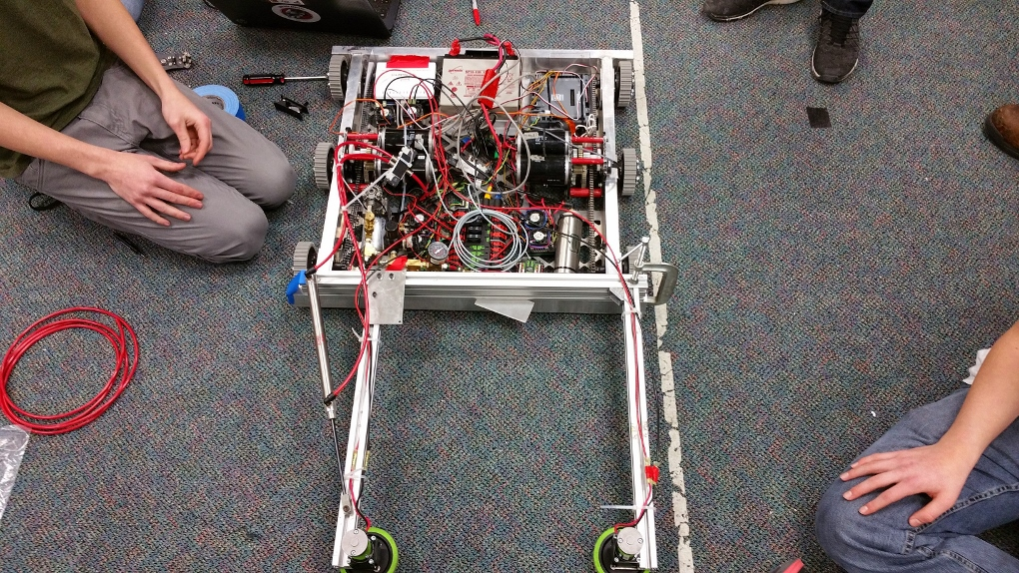
Bad Wiring Practices

Slide 10
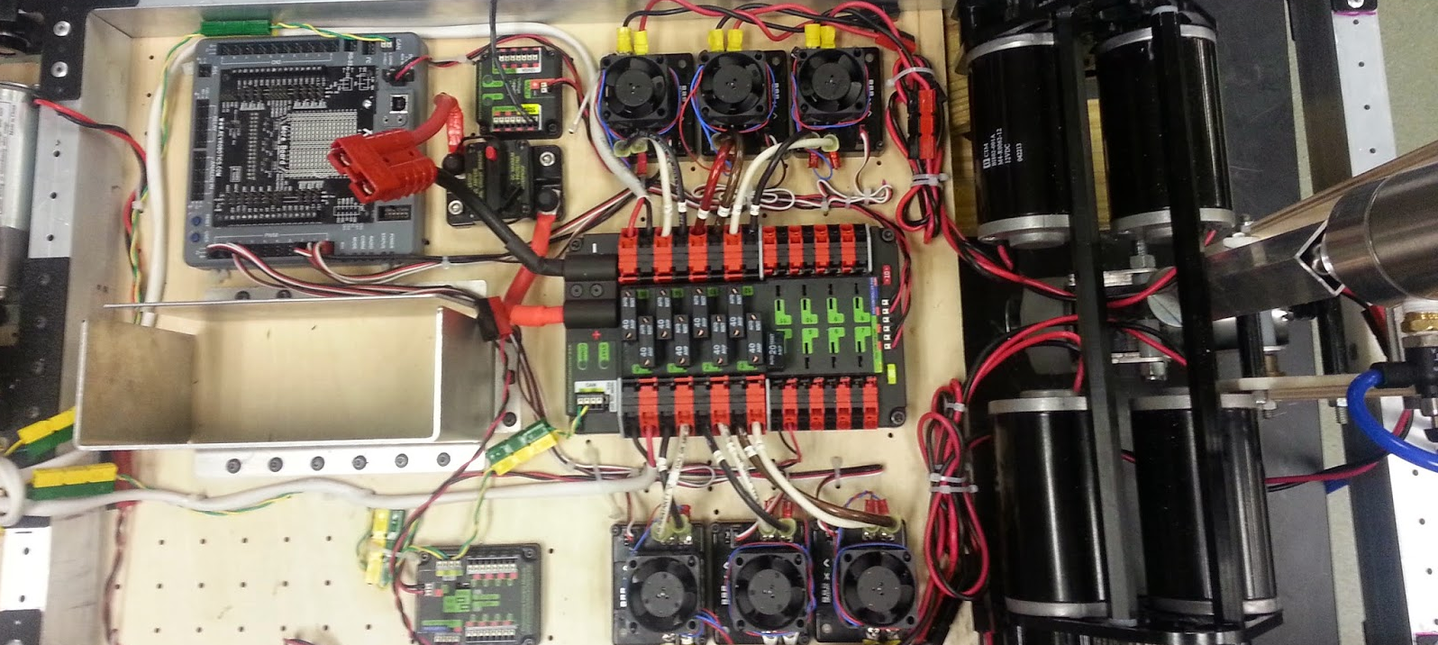
Good Wiring Practices

Slide 11
Tips for good wiring

Slide 12
Using a Multimeter

Slide 13
Tips for using a Multimeter

Slide 14
Wiring Table

Slide 15
Programming
Instructions to the system

